Slide 1


Dadi Ke Nukshe
PROJECT DEVELOPERS :
21CE074 : Faizan Momin
21CE081 : Nayi Om
21CE082 : Disha Odedara
21CE084 : Kalp Pandya
GUIDED BY : Sneha Padhiar
U & PU PATEL DEPARTMENTOF COMPUTEE ENGINEERING

Slide 2
Index
Definition / motive of our project
main Goal
Functionality of website
Information about project
Gathered information of website
Scope of our website
Functional Requirements
Graphical User Interface
Demonstration after presentation

Slide 3
Definition
Our main motto of this project is to give information to user about some homely cures of different illnesses like cold, fever, headache, migraine, throat irritation, stomach ache, etc.
Our information is based on home made cure (nuskhe) which generally given by our elders.
We also provide some basic information of illness causes and basic treatments.
Use can also suggest the home made cure (nuskhe) to us.

Slide 4
Main Goal
Solve The Problem Of people by
using this Website to cure their illness.
Users can find information about natural herbs.
User can cure their selves in low cost.
User can now know our old culture how the rushimunis cure with natural herbs.

Slide 5
Information
Home page / Section
Explore page / Section
Herbal Ingredient page / Section
Blog page / Section
About us / Section

Slide 6
Information
Home page / Section
where you can find some brief about this website and something that what our main motive is.
Explore page / Section
Where user can find the easy or we can say dadi ke nuskhe type cures through available home remedies.

Slide 7
Information
Explore page / Section
where user can find different type of herbal ingredients name and there use in cure.
Blog page / Section
Where user can find the effect or strength of that herbal ingredient which are used by different people, and their experience in covid-19.

Slide 8
Information
Explore page / Section
where user can find different type of herbal ingredients name and there use in cure.
Blog page / Section
Where user can find the effect or strength of that herbal ingredient which are used by different people, and their experience in covid-19.

Slide 9
Information
About us page / Section
where user can find the information about our team and other things.

Slide 10
Information : more about project
Information about different disease
Symptoms of different disease
Cure of disease as our dadi says
Knowledge about herbal ingredient
Herbal ingredient like tulsi, aswagandha, turmeric etc.
Some famous blogs of cure by herbals ingredient.

Slide 11
Information : more about project
This website will help user to cure their self at home
Because in the situation like pandemic people cant go outside.
And also the clinics are very crowdy.
In pandemic also doctors where charging more money for treatment
So in this type of scenario this website can help them to cure their self at home at very low cost.

Slide 12
Gathered Information For Website
Diseas information: https://github.com/om51203/sgp/blob/main/diseas%20info.docx
Herbal ingredients:
https://github.com/om51203/sgp/blob/main/herbal_ingridients.docx
Famous blogs:
https://github.com/om51203/sgp/blob/main/Famous%20blogs.docx

Slide 13
Scope Of Our Website
After pandemic all people are approaching towards “ayurvedic” cures so people will go on internet for finding details about herbal ingredient.
we are thinking for adding user feedback which make our website user flexible.

Slide 14




Functional Requirements

Slide 15
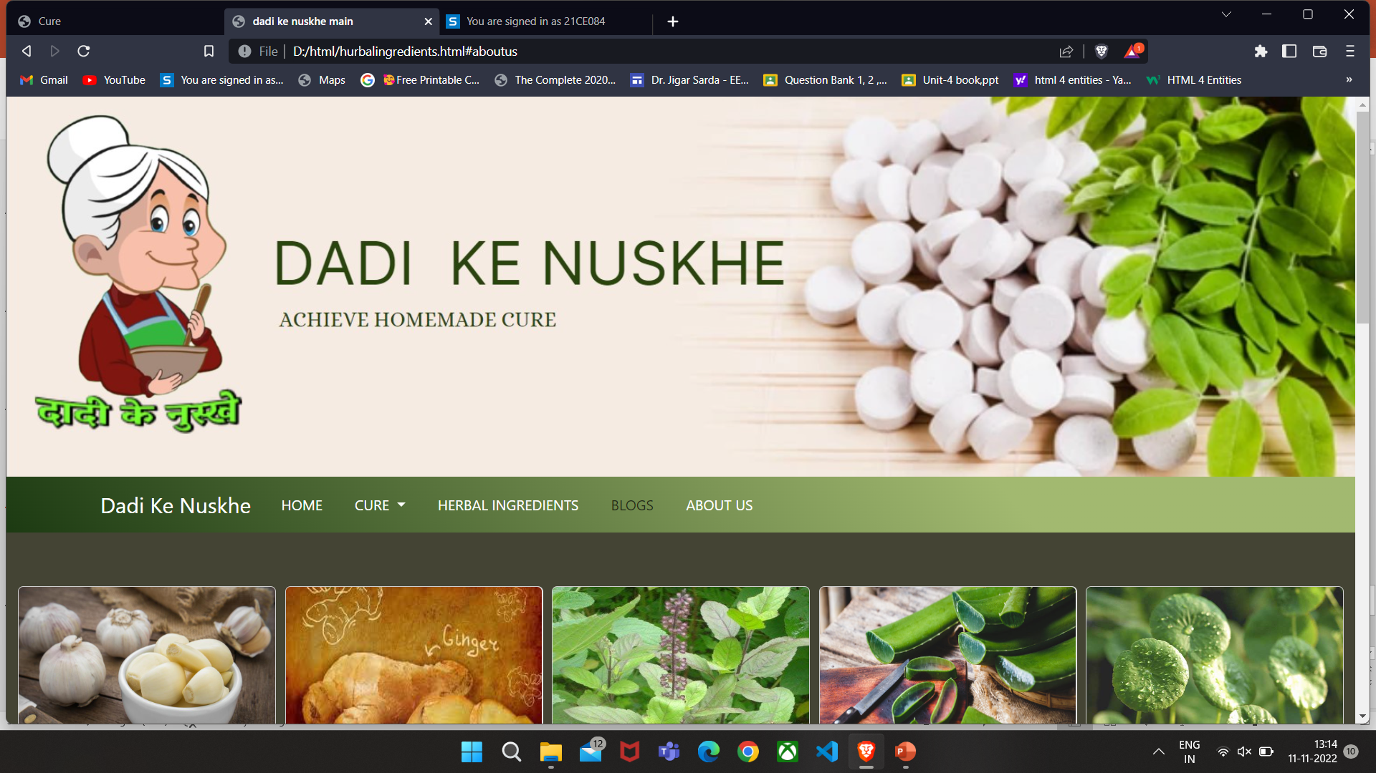
Graphical User Interface

Slide 16


